Slide 1
Searching Algorithm

Slide 2
Objectives
At the end of the lesson students should be able to
Define the term searching algorithm
Describe what is linear searching.
Describe what is binary search method.
Explain how binary search method is done.
Write simple code in C# or pseudocode for binary search.

Slide 3
What is a Sorting Algorithm?
Sorting is a process of ordering or placing a list of elements from a collection in some kind of order. It store data in sorted order.
Sorting can be done in ascending and descending order. The arrangement of data in sequence makes searching easier.
A common task that computers need to perform is sorting data into a particular order. It takes an unordered list and make it into an ordered one

Slide 4
Different types of Sorting Algorithm in Data structures
Sorting algorithms can be categorized as
Simple Sorts These types of algorithms are efficient on the small amount of data but cannot handle large data. They are fast and efficient due to low overhead
Efficient Sorts These algorithms can be used on large lists and complicated programs which at time require additional space or more iterations, thus resulting in more complex algorithms.

Slide 5


Types of Simple Sorting Algorithm
Types of Efficient Sorting Algorithm
Merge sort
Quick Sort
Heap Sort
Bubble sort
Insertion Sort
Selection Sort

Slide 6

Bubble Sort

Slide 7
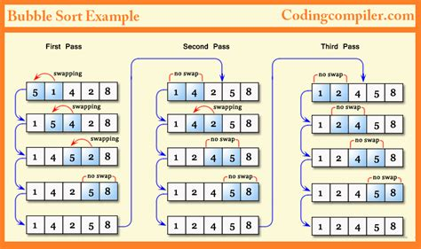
Bubble Sort
Instead of searching an array as a whole, the bubble sort works by comparing adjacent pairs of elements in the array from left to right.
If the elements are not in the correct ordered, they are swapped so that the largest of the two moves up.
This process continues until the largest of the objects, eventually "bubbles" up to the highest position in the array.
This is known as pass 1.
After this occurs, the search for the next largest object begins.
The swapping continues until the whole array is in the correct order.

Slide 8

https://www.youtube.com/watch?v=xli_FI7CuzA

Slide 9
Pseudocode on bubble sort
Bubble sort(array):
n= length of array
for i in range (n):
for j in range(n-1:
if array[j] > [j+1]:
swap(array[j], array[j+1])
Array is the array to be sorted. The function bubble sort compares adjacent elements in the array and swaps them if they are in the wrong order. It repeats this process until the array is fully sorted.
The outer loop iterates over each item in the array, and the inner loop iterates over each adjacent pair of elements. If the left element is greater than the right element, the swap function (which exchange the two elements) is called. This process is repeated until all adjacent pairs have been compared, and the largest element Hs bubbled up to the end of the array. The outer loop then repeats the process, but with one fewer element to sort(since the largest element is already in its correct position)

Slide 10
Python codes for Bubble sort
def bubble_sort(array):
n=len(array)
for i in range(n):
for j in range(n-1):
if array[j] > array[j+1]:
array[j], array[j+1] = array[j+1], array[j]
my_array =[5,1,10,2,5]
bubble_sort(my_array)
print(my_array)

Slide 11

What is a Search Algorithm?
Searching is an operation or a technique that helps finds the place of a given element or value in the list. It uses a step-by-step procedure to locate the item in a collection of data
Any search is said to be successful or unsuccessful depending upon whether the element that is being searched is found or not.
When searching for data, the difference between a fast search and a slower one often lies in the use of the proper search algorithm

Slide 12
Types of Search Algorithm
Some of the standard searching technique that is being followed in the data structure are:
Linear Search or Sequential Search
Binary Search

Slide 13
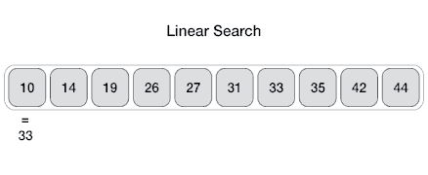
Linear Search
This is the simplest method for searching where the element to be found is searched sequentially in the list.
The searched item position is returned if the key element to be searched is available in the list, otherwise -1 is returned
This method can be performed on a sorted or an unsorted list (usually arrays).
In case of a sorted list searching starts from 0th element and continues until the element is found from the list or the element whose value is greater than (assuming the list is sorted in ascending order), the value being searched is reached.
Linear algorithms tend to be rather inefficient - particularly when working with long arrays.

Slide 14

Video Review

Slide 15
Pseudocode for linear search
Please note your teacher’s explanation of the pseudocode below
LinearSearch(list, target_element):
for each item in array:
if element ==target
return index of element
return -1
Array is the array you want to search through and target is the value you're looking for.
The function “linearsearch” loops through each element of the array and compares it to the target.
If it finds the match, it returns the index of that element. If it reaches the end of the array without finding a match it returns -1 to indicates that the target is not present in the array.
In your copy books draw a flowchart to represent the above algorithm

Slide 16
Pseudocode for linear search
LINEAR_SEARCH(array, size, target_value)
index <- 0
while index < size and array[index] != target_value do
index <- index + 1
if index < size then
return index
else
return -1
The algorithm works as follows:
Initialize the index variable index to 0.
While index is less than size (the number of elements in the array) and the element at index is not equal to target_value, increment index by 1.
After the loop ends, if index is less than size, it means the target_value was found at index, so return index.
If index is equal to or greater than size, it means the target_value was not found in the array, so return -1
array is the array to be searched
size is the number of elements in the array
target_value is the value to be searched for
index is the index variable used to traverse the array
The function returns the index of the first occurrence of target_value in array, or -1 if target_value is not found

Slide 17
Pseudocode for linear search
// Input: array, size, target_value
array <- [...] // Initialize the array with values
size <- length(array) // Get the number of elements in the array
target_value <- ... // Value to be searched for
index <- 0
while index < size and array[index] != target_value do
index <- index + 1
if index < size then
output "Target value found at index:", index
else
output "Target value not found in the array."
The algorithm works as follows:
Initialize the array with values and assign the number of elements to the variable size.
Assign the value to be searched for to the variable target_value.
Initialize the index variable index to 0.
While index is less than size (the number of elements in the array) and the element at index is not equal to target_value, increment index by 1.
After the loop ends, if index is less than size, it means the target_value was found at index, so output a message indicating the index where the target value was found.
If index is equal to or greater than size, it means the target_value was not found in the array, so output a message indicating that the target value was not found.

Slide 18
Python code on Linear Search
def linear_search(lst,target):
for i in range(len(lst)):
if lst[i] == target:
return i
return -1
lst = [10,20,30,4,5]
target = 5
result = linear_search(lst, target)
print(result)

